Slide 1
Topic D: Fields D.2 – Electric fields (SL)
Guiding questions
Which experiments provided evidence to determine the nature of the electron?
How can the properties of fields be understood using both an algebraic approach and a visual
representation?
Notes:
© 2014 By Timothy K. Lund

Slide 2
Topic D: Fields D.2 – Electric fields (SL)
Understandings:
Students should understand:
• the direction of forces between the two types of electric charge
•Coulomb’s law as given by F = kq₁q₂/r² for charged bodies treated as point charges where k = 1/4πε₀
• the conservation of electric charge
• Millikan’s experiment as evidence for quantization of electric charge
Notes:
‹#›
© 2014 By Timothy K. Lund

Slide 3
Topic D: Fields D.2 – Electric fields (SL)
Understandings:
Students should understand:
• that the electric charge can be transferred between bodies using friction, electrostatic induction and by contact, including the role of grounding (earthing)
• the electric field strength as given by E = F/q
• electric field lines
• the relationship between field line density and field strength
• the uniform electric field strength between parallel plates as given by E = V/d
Notes:
‹#›
© 2014 By Timothy K. Lund

Slide 4
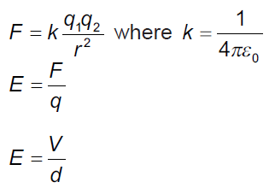
Topic D: Fields D.2 – Electric fields (SL)
Data booklet reference:
Notes:
‹#›
© 2014 By Timothy K. Lund

Slide 5
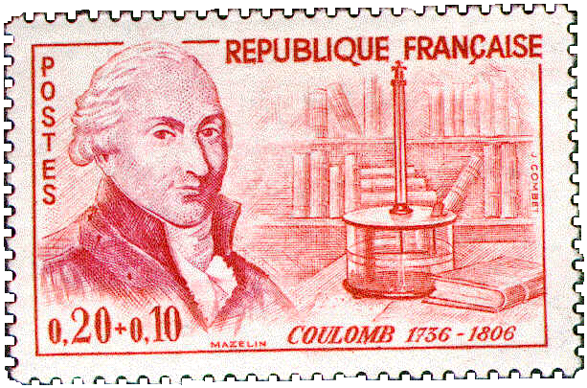


Topic D: Fields D.2 – Electric fields (SL)
Coulomb’s law
∙Charles-Augustin de Coulomb studied charge, and discovered the following relationship (now called “Coulomb’s Law”):
The magnitude of the electrostatic force of interaction between two point charges is directly proportional to the scalar multiplication of the magnitudes of charges and inversely proportional to the square of the distance between them.
Notes:
© 2014 By Timothy K. Lund

Slide 6
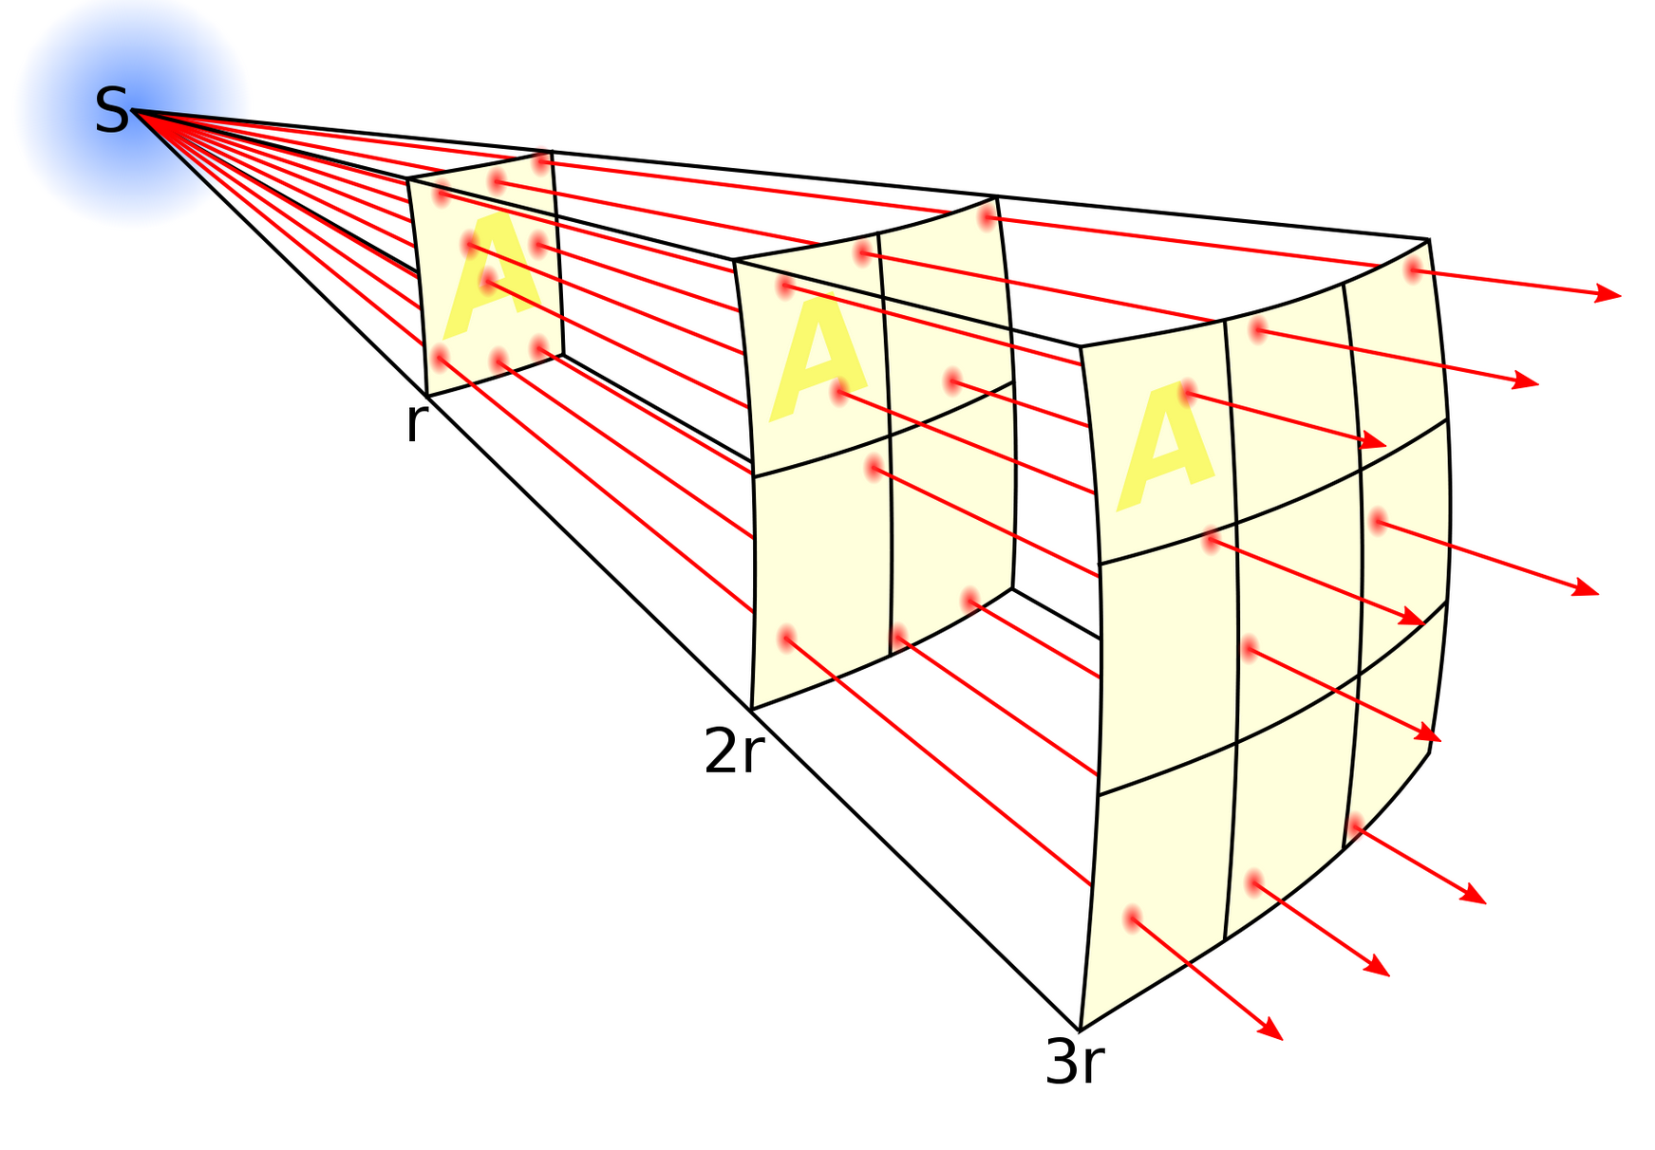
Topic D: Fields D.2 – Electric fields (SL)
Coulomb’s law
∙The inverse square law:
As distance increases, the same amount of energy is “spread out” over a larger (surface) area
Notes:
© 2014 By Timothy K. Lund

Slide 7
Topic 5: Electricity and magnetism 5.1 – Electric fields
Coulomb’s law
∙Charles-Augustin de Coulomb studied charge, and discovered an inverse square law for the electric force F between two point charges q₁ and q₂ separated by distance r :
∙k is called Coulomb’s constant. Beware. There is another constant that is designated k called Boltzmann’s constant used in thermodynamics.
∙There is an alternate form of Coulomb’s law:
F = kq₁q₂ / r ²
Coulomb’s law
where k = 8.99×10⁹ N m² C⁻²
F = (1/[4πε₀])q₁q₂ / r ²
Coulomb’s law
where ε₀ = 8.85×10⁻¹² C² N⁻¹ m⁻²
Notes:
© 2014 By Timothy K. Lund

Slide 8
Topic D: Fields D.2 – Electric fields (SL)
Coulomb’s law
PRACTICE: Show that the numeric value of 1/[4πε₀] equals the numeric value of k.
SOLUTION:
∙We know that k = 8.99×10⁹.
∙We know that ε₀ = 8.85×10⁻¹².
∙Then 1/[4πε₀] = 1 / [4π×8.85×10⁻¹²] = 8.99×10⁹ = k.
FYI
Either F = kq₁q₂ / r ² or F = (1/[4πε₀])q₁q₂ / r ² can be used. It is your choice. The first is easiest, though.
In Topic D.1, we discovered that the gravitational force is also an inverse square law.
Notes:
© 2014 By Timothy K. Lund

Slide 9
Topic D: Fields D.2 – Electric fields (SL)
Coulomb’s law
PRACTICE:
Find the Coulomb force between two electrons located 1.0 cm apart.
SOLUTION:
∙Note r = 1.0 cm = 0.010 m.
∙Note q₁ = e = 1.60×10⁻¹⁹ C.
∙Note q₂ = e = 1.60×10⁻¹⁹ C.
∙From F = kq₁q₂ / r ²
F = 8.99×10⁹×(1.60×10⁻¹⁹)² / 0.010²
= 2.30×10⁻²⁴ N.
∙Since like charges repel the electrons repel.
Notes:
© 2014 By Timothy K. Lund

Slide 10
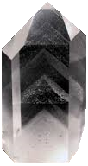
Topic D: Fields D.2 – Electric fields (SL)
Coulomb’s law - permittivity
PRACTICE: The ε₀ in Coulomb’s law F = (1/[4πε₀])q₁q₂ / r ² is called the permittivity of free space. In general, different materials have different permittivities ε, and Coulomb’s law has a more general form: F = (1/[4πε])q₁q₂ / r ². If the two electrons are embedded in a chunk of quartz, having a permittivity of 12ε₀, what will the Coulomb force be between them if they are 1.0 cm apart?
SOLUTION:
F = (1/[4πε])q₁q₂ / r ²
= (1/[4π×12×8.85×10⁻¹²]) (1.60×10⁻¹⁹)² / 0.010²
= 1.92×10⁻²⁵ N.
Notes:
© 2014 By Timothy K. Lund

Slide 11
Topic D: Fields D.2 – Electric fields (SL)
Coulomb’s law – extended distribution
∙We can use integral calculus to prove that a spherically symmetric shell of charge Q acts as if all of its charge is located at its center.
∙Thus Coulomb’s law works not only for point charges, which have no radii, but for any spherical distribution of charge at any radius.
∙Be very clear that r is the distance between the centers of the charges.
Q
q
r
Notes:
© 2014 By Timothy K. Lund

Slide 12
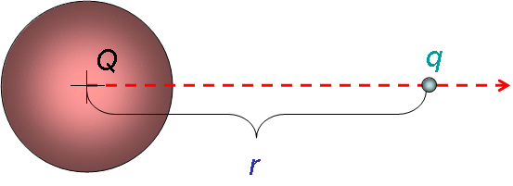
Topic D: Fields D.2 – Electric fields (SL)
Coulomb’s law – extended distribution
EXAMPLE: A conducting sphere of radius 0.10 m holds an electric charge of Q = ⁺125 μC. A charge q = -5.0 μC is located 0.30 m from the surface of Q. Find the electric force between the two charges.
SOLUTION:
∙Use F = kQq / r ², where r is the distance between the centers of the charges.
∙Then r = 0.10 + 0.30 = 0.40 m. Thus
F = kQq / r ²
= 8.99×10⁹×125×10⁻⁶× ⁻5.0×10⁻⁶ / 0.40 ²
= ⁻35 N.
Notes:
© 2014 By Timothy K. Lund

Slide 13
Topic 5: Electricity and magnetism 5.1 – Electric fields
Electric field - definition
∙Suppose a charge q is located a distance r from a another charge Q.
∙We define the electric field strength E as the force per unit charge acting on q due to the presence of Q.
∙The units are Newtons per Coulomb (N C⁻¹).
E = F / q
electric field strength
PRACTICE: Find the electric field strength 1.0 cm from an electron.
SOLUTION: We have already found the Coulomb force between two electrons located 1.0 cm apart. We just divide our previous answer by one of the charges:
∙Then E = F / q = 2.3×10⁻²⁴ / 1.6×10⁻¹⁹ = 1.4×10⁻⁵ N C⁻¹.
Notes:
© 2014 By Timothy K. Lund

Slide 14
Topic D: Fields D.2 – Electric fields (SL)
Electric field – definition
EXAMPLE: Let q be a small charge located a distance r from a larger charge Q. Find the electric field strength due to Q at a distance r from the center of Q.
SOLUTION: Use E = F / q and F = kQq / r ².
∙From E = F / q we have Eq = F.
∙And from Coulomb’s law we can write
Eq = F = kQq / r ²
Eq = kQq / r ²
∙Thus the electric field strength is given by
E = kQ / r ²
electric field strength at a distance r from the center of a charge Q
Notes:
© 2014 By Timothy K. Lund

Slide 15
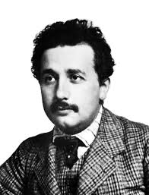
Topic D: Fields D.2 – Electric fields (SL)
Electric field – the field model
∙In 1905 Albert Einstein published his Special Theory of Relativity, which placed an upper bound on the speed anything in the universe could reach.
∙According to relativity, nothing can travel faster than the speed of light c = 3.00×10⁸ ms⁻¹.
∙Thus the “Coulomb force signal” cannot propagate faster than the speed of light.
∙Since the electric force was thought to be an action-at-a-distance force, a significant problem arose with the advent of relativity which required a paradigm shift from action-at-a-distance to the new idea of field.
Notes:
© 2014 By Timothy K. Lund

Slide 16
Topic D: Fields D.2 – Electric fields (SL)
Electric field – the field model
∙In the action-at-a-distance model, if the Coulomb force signal cannot propagate faster than the speed of light, electrons trapped in orbits about nuclei cannot instantaneously feel the Coulomb force, and thus cannot instantaneously adjust their motion on time to remain in a circular orbit.
∙Since electrons in orbit around nuclei do not spiral away, a new model called the field model was developed which theorized that the space surrounding a nucleus is distorted by its charge in such a way that the electron “knows” how to act.
Notes:
© 2014 By Timothy K. Lund

Slide 17
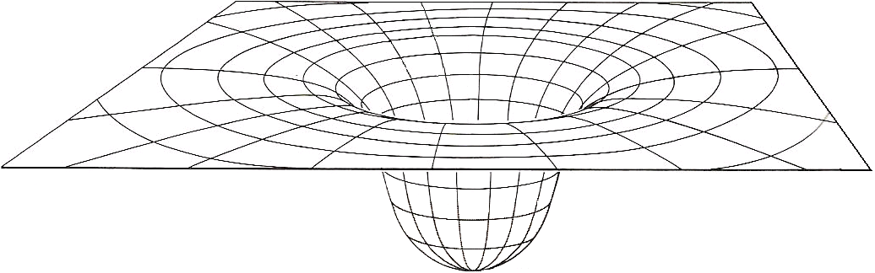
Topic D: Fields D.2 – Electric fields (SL)
Electric field – the field model
∙In the field model the charge Q distorts its surrounding space.
∙Then the electrons know which way to curve in their orbits, not by knowing where Q is, but by knowing the local curvature of their immediate environment.
Q
Notes:
© 2014 By Timothy K. Lund

Slide 18
Topic D: Fields D.2 – Electric fields (SL)
Electric field – test charges
∙In order to explore the electric field in the surrounding a charge we use tiny POSITIVE test charges.
PRACTICE: Observe the test charges as they are released. What is the sign of Q?
SOLUTION: Q is attracting the test charges
and test charges are (+), so Q must be (-).
q₁
q₂
E₁
E₂
Q
Notes:
© 2006 By Timothy K. Lund

Slide 19
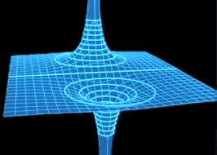
Topic D: Fields D.2 – Electric fields (SL)
Electric field – test charges
PRACTICE: Observe the test charge as it is released. What is the sign of Q?
SOLUTION:
∙Q is repelling the test charge and since test charges are by definition (+), Q must also be (+).
Q
Notes:
© 2006 By Timothy K. Lund

Slide 20
Topic D: Fields D.2 – Electric fields (SL)
Electric field – test charges
∙ By “placing” a series of test charges about a negative charge, we can map out its electric field:
Q
FYI
∙The field arrows of the inner ring are longer than the field arrows of the outer ring and all field arrows point to the centerline.
Notes:
© 2006 By Timothy K. Lund

Slide 21
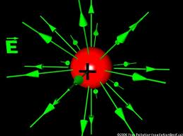
Topic D: Fields D.2 – Electric fields (SL)
Electric field – sketching
PRACTICE: We can simplify our drawings of electric fields by using top views and using rays. Which field is that of the…
(a) Largest negative charge?
(b) Largest positive charge?
(c) Smallest negative charge?
(d) Smallest positive charge?
SOLUTION: The larger the charge, the more concentrated the field.
∙Lines show the direction a positive test charge will go.
∙Outward is (+) charge, inward (-).
D
A
A
B
C
E
D
C
E
F
Notes:
© 2006 By Timothy K. Lund

Slide 22
Topic D: Fields D.2 – Electric fields (SL)
Solving problems involving electric fields
EXAMPLE: Two charges of -0.225 C each are located at opposite corners of a square having a side length of 645 m. Find the electric field vector at
the center of the square, and
(b) one of the unoccupied corners.
SOLUTION: Start by making a sketch.
The opposing fields cancel so E = 0.
(b) The two fields are at right angles.
E₁ = (8.99×10⁹)(-0.225) / 645 ² = -4860 NC⁻¹
E₂ = (8.99×10⁹)(-0.225) / 645 ² = -4860 NC⁻¹
E² = E₁² + E₂² = 2(4860)² = 47239200 →E = 6870 NC⁻¹.
q₂
E₂
(b)
E₁
s
(a)
q₁
s
E₁+E₂
E₁
E₂
sum points to center of square
(↓).
(←).
Notes:
© 2006 By Timothy K. Lund

Slide 23

Topic D: Fields D.2 – Electric fields (SL)
Solving problems involving electric fields
PRACTICE:
Two stationary charges are shown. At which point is the electric field strength the greatest?
SOLUTION:
∙Sketch in the field due to each charge at each point.
∙Fields diminish as 1 / r².
∙Fields point away from (+) and toward (-).
∙The only place the fields add is point B.
Notes:
© 2006 By Timothy K. Lund

Slide 24
Topic D: Fields D.2 – Electric fields (SL)
Solving problems involving electric fields
PRACTICE: An isolated metal sphere of radius 1.5 cm has a charge of -15 nC placed on it.
(a) Sketch in the electric field lines outside the sphere.
(b) Find the electric field strength at the surface of the sphere.
SOLUTION:
(a) Field lines point towards (-) charge.
(b) The field equation works as if all of the charge is at the center of the spherical distribution.
E = kQ / r ²
= (8.99×10⁹)(15×10⁻⁹) / 0.015² = 6.0×10⁵ NC⁻¹.
(-)
Notes:
© 2006 By Timothy K. Lund

Slide 25
Topic D: Fields D.2 – Electric fields (SL)
Solving problems involving electric fields
PRACTICE: An isolated metal sphere of radius 1.5 cm has a charge of -15 nC placed on it.
(c) An electron is placed on the outside surface of the sphere and released. What is its initial acceleration?
SOLUTION:
(c) The electron feels force F = Eq so that
F = Ee = (6.0×10⁵)(1.6×10⁻¹⁹) = 9.6×10⁻¹⁴ N.
But F = ma so that
a = F / m
= (9.6×10⁻¹⁴) / (9.11×10⁻³¹) = 1.1×10¹⁷ m s⁻².
(-)
Notes:
© 2006 By Timothy K. Lund

Slide 26
Topic D: Fields D.2 – Electric fields (SL)
Electric monopoles and dipoles
∙Because there are two types of electric charge, electric fields can have field lines pointing inward AND outward.
∙A single charge is called a monopole.
MONOPOLES
Negative sphere of charge
Positive sphere of charge
Notes:
© 2006 By Timothy K. Lund

Slide 27
Topic D: Fields D.2 – Electric fields (SL)
Electric monopoles and dipoles
∙If two opposite electric monopoles are near enough to each other their field lines interact as shown here:
(-) MONOPOLE
(+) MONOPOLE
DIPOLE
Notes:
© 2006 By Timothy K. Lund

Slide 28
Topic D: Fields D.2 – Electric fields (SL)
Solving problems involving electric fields
EXAMPLE: Suppose test charges are placed at points A and B in the electric field of the dipole, as shown. Trace their paths when released.
SOLUTION:
∙Just remember: Test charges travel with the field arrows and on the field lines.
A
B
Notes:
© 2006 By Timothy K. Lund

Slide 29
Topic D: Fields D.2 – Electric fields (SL)
Solving problems involving electric fields
PRACTICE: Suppose small negative charges are placed at points A and B in the electric field of the dipole, as shown. Trace their paths when released.
SOLUTION:
∙Just remember: (-) charges travel against the field arrows and on the field lines.
A
B
Notes:
© 2006 By Timothy K. Lund

Slide 30
Topic D: Fields D.2 – Electric fields (SL)
Solving problems involving electric fields
PRACTICE: If the charge on a 25 cm radius metal sphere is +150 μC, calculate
(a) the electric field strength at the surface.
(b) the field strength 25 cm from the surface.
(c) the force on a -0.75 μC charge placed 25 cm from the surface.
SOLUTION: Use E = kQ / r², and for (c) use E = F / q.
(a) E = kQ / r²
= (8.99×10⁹)(150×10⁻⁶) / 0.25 ² = 2.2×10⁷ NC⁻¹.
(b) E = (8.99×10⁹)(150×10⁻⁶) / 0.50 ² = 5.4×10⁶ NC⁻¹.
(c) F = Eq = (5.4×10⁶)(-0.75×10⁻⁶) = -4.0 N.
The minus sign means it is an attractive force.
Notes:
© 2006 By Timothy K. Lund

Slide 31
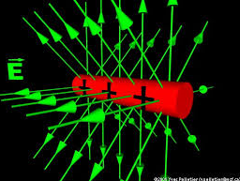
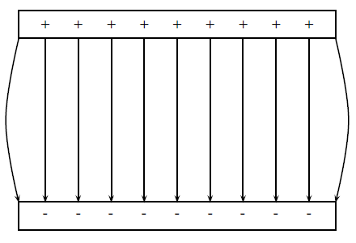
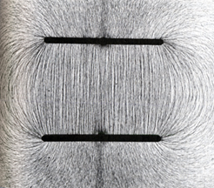
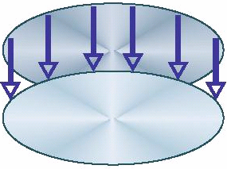
Topic D: Fields D.2 – Electric fields (SL)
Electric field – between parallel plates
EXAMPLE: If we take two parallel plates of metal and give them equal and opposite charge, what does the electric field look like between the plates?
SOLUTION: Just remember: Field lines point away from (+) charge and toward (-) charge.
(+)
E
(-)
Notes:
© 2006 By Timothy K. Lund

Slide 32
Topic D: Fields D.2 – Electric fields (SL)
Electric field – between parallel plates
PRACTICE: Justify the statement “the electric field strength is uniform between two parallel plates.”
SOLUTION:
∙Sketch the electric field lines between two parallel plates.
∙Now demonstrate that the electric field lines have equal density everywhere between the plates.
Notes:
© 2006 By Timothy K. Lund

Slide 33
Topic D: Fields D.2 – Electric fields (SL)
Electric field – between parallel plates
PRACTICE: The uniform electric field strength inside the parallel plates is 275 N C⁻¹. A ⁺12 μC charge having a mass of 0.25 grams is placed in the field at A and released.
(a) What is the electric force acting on the charge?
(b) What is the weight of the charge?
SOLUTION:
(a) F = Eq = (275)(12×10⁻⁶) = 0.0033 N.
(b) Change grams to kg by jumping 3 places left:
F = mg = (0.00025)(9.8) = 0.0025 N.
0.025 m
E
A
Notes:
© 2006 By Timothy K. Lund

Slide 34
Topic D: Fields D.2 – Electric fields (SL)
Electric field – between parallel plates
PRACTICE: The uniform electric field strength inside the parallel plates is 275 N C⁻¹. A ⁺12 μC charge having a mass of 0.25 grams is placed in the field at A and released.
(c) What is the acceleration of the charge?
SOLUTION: Use F_{net} = ma.
The electric force is trying to make the charge go up, and the weight is trying to make it go down. Thus
F_{net} = 0.0033 - 0.0025 = 0.0008 N.
F_{net} = ma
0.0008 = 0.00025a → a = 3.2 m s⁻² ( ↑).
0.025 m
E
A
Notes:
© 2006 By Timothy K. Lund

Slide 35
Topic D: Fields D.2 – Electric fields (SL)
Electric Potential
∙Because electric charges experience the electric force, when one charge is moved in the vicinity of another, work W is done (recall that work is a force times a displacement).
∙We define the electric potential V as the amount of electric potential energy that a unitary point electric charge would have if located at any point in space (e.g. at point A)
∙ It is equal to the work done by an electric field in carrying a unit positive charge to a location from infinity.
Q
A
∞
Notes:
© 2006 By Timothy K. Lund

Slide 36
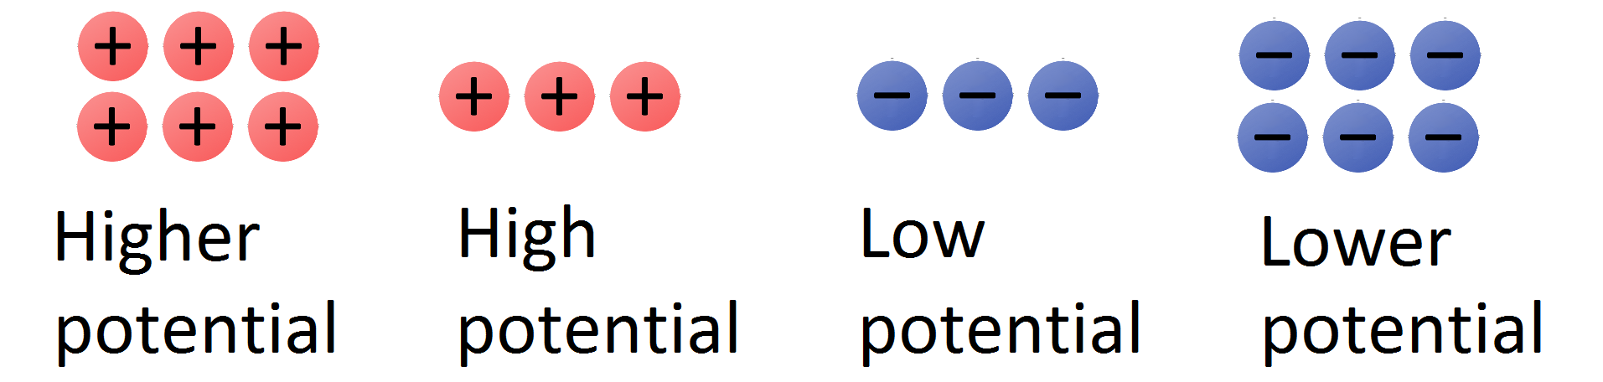
Topic D: Fields D.2 – Electric fields (SL)
Electric Potential
The higher the concentration of positive (+) charge in an area, the higher the electric potential is in that area
Likewise, the higher the concentration of negative (-) charge in an area, the lower the electric potential is in that area.
Note: Electric potential is different to the electric potential energy!
Notes:
© 2006 By Timothy K. Lund

Slide 37
Topic D: Fields D.2 – Electric fields (SL)
Electric Potential
Positive (+) charges will naturally move from higher to lower electric potentials.
Much like how a “positive” mass moves from a higher to lower gravitational potential
Note: Negative (-) charges will naturally move from lower to higher electric potentials.
There is no analog to this with gravitation because there is no “negative” mass.
Notes:
© 2006 By Timothy K. Lund

Slide 38
Topic D: Fields D.2 – Electric fields (SL)
Potential difference
∙Because electric charges experience the electric force, when one charge is moved in the vicinity of another, work W is done (recall that work is a force times a displacement).
∙We define the potential difference V at any point A and B as the amount of work W done per unit charge in moving a point charge from A to B.
∙Note that the units of V are JC⁻¹ which are volts V.
Q
q
A
B
V = V_{B} – V_{A} = W / q
potential difference
Notes:
© 2006 By Timothy K. Lund

Slide 39
Topic D: Fields D.2 – Electric fields (SL)
Potential difference
PRACTICE: A charge of q = ⁺15.0 μC is moved from point A, having an electric potential of 25.0 V to point B, having a electric potential of 18.0 V.
(a) What is the potential difference undergone by the charge?
(b) What is the work done in moving the charge from A to B?
SOLUTION:
(a) V = V_{B} – V_{A} = 18.0 – 25.0 = ⁻7.0 V.
(b) W = qV = 15.0×10⁻⁶×⁻7.0 = ⁻1.1 ×10⁻⁴ J.
A
B
q
FYI
∙Many books use ΔV instead of V.
Notes:
© 2006 By Timothy K. Lund

Slide 40
Topic D: Fields D.2 – Electric fields (SL)
Potential difference – the electronvolt
∙When speaking of energies of individual charges (like electrons in atoms), rather than large groups of charges (like currents through wire), Joules are too large and awkward.
∙We define the electronvolt eV as the work done when 1 elementary charge e is moved through a potential difference of 1V. (1V = 1 JC⁻¹)
∙From W = qV we see that
1 eV = eV = (1.60×10⁻¹⁹ C)(1 JC⁻¹) = 1.60×10⁻¹⁹ J.
1 eV = 1.60×10⁻¹⁹ J
electronvolt conversion
FYI ∙We will use electronvolts in Topic 7 when we study atomic physics.
Notes:
© 2006 By Timothy K. Lund

Slide 41
Topic D: Fields D.2 – Electric fields (SL)
Potential difference – the electronvolt
PRACTICE: An electron is moved from Point A, having a voltage (potential) of 25.0 V, to Point B, having a voltage (potential) of 18.0 V.
(a) What is the work done (in eV and in J) on the electron by the external force during the displacement?
SOLUTION:
∙Use W = q(V_{B} – V_{A}). Then
W = -e(18.0 V – 25.0 V) = 7.0 eV.
7.0 eV (1.60×10⁻¹⁹ J / eV) = 1.12 ×10⁻¹⁸ J.
A
B
q
FYI
∙Since the electron is more attracted to A than B, we have stored this energy as potential energy.
Notes:
© 2006 By Timothy K. Lund

Slide 42
Topic D: Fields D.2 – Electric fields (SL)
Potential difference – the electronvolt
PRACTICE: An electron is moved from Point A, having a voltage (potential) of 25.0 V, to Point B, having a voltage (potential) of 18.0 V.
(b) If the electron is released from Point B, what is its speed when it reaches Point A?
SOLUTION: Use ΔE_{K} + ΔE_{P} = 0 with ΔE_{P} = ⁻1.12 ×10⁻¹⁸.
ΔE_{K} = ⁻ΔE_{P}
(1/2)mv² – (1/2)mu² = ⁻(⁻1.12 ×10⁻¹⁸)
(1/2)mv² – (1/2)m0² = 1.12 ×10⁻¹⁸
(1/2)(9.11×10⁻³¹)v² = 1.12 ×10⁻¹⁸
v ² = 2.45×10¹²
v = 1.57×10⁶ ms⁻¹.
A
B
q
Notes:
© 2006 By Timothy K. Lund

Slide 43
Topic D: Fields D.2 – Electric fields (SL)
Potential difference – path independence
EXAMPLE: A charge of q = ⁺15.0 μC is moved from point A, having a voltage (potential) of 25.0 V to point B, having a voltage (potential) of 18.0 V, in three different ways. What is the work done in each case?
SOLUTION:
∙The work is independent of the path because the electric force is a conservative force.
∙W = qV = 15.0×10⁻⁶× ⁻7.0 = ⁻1.1 ×10⁻⁴ J. Same for all.
A
B
FYI
∙We found out in Topic D.1 that gravity is also a conservative force.
Notes:
© 2006 By Timothy K. Lund

Slide 44


Topic D: Fields D.2 – Electric fields (SL)
Potential difference – between parallel plates
PRACTICE: Two parallel plates with plate separation d are charged up to a potential difference of V simply by connecting a battery (shown) to them. The electric field between the plates is E. A positive charge q is moved from A to B.
(a) How much work is done in moving q through the distance d?
(b) Find the potential difference V across the plates.
SOLUTION: Use W = Fd cos θ, F = Eq, and W = qV.
(a) W = Fd cos 0° = (Eq)d.
(b) qV = Eqd → V = Ed.
A
d
E
B
Notes:
© 2006 By Timothy K. Lund

Slide 45
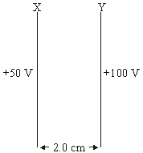
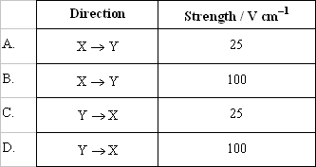
Topic D: Fields D.2 – Electric fields (SL)
Potential difference – between parallel plates
PRACTICE: Two parallel plates with plate separation 2.0 cm are charged up to the potential difference shown. Which one of the following shows the correct direction and strength of the resulting electric field?
SOLUTION:
∙Since the greater positive is plate Y, the electric field lines point from Y → X.
∙From V = Ed we see that
E = V / d
= (100 – 50) / 2
= 25 V cm⁻¹.
Notes:
© 2006 By Timothy K. Lund

Slide 46
Millikan’s Oil Drop Experiment
Charge of electron – very important application of uniform electric field between two plate – Robert Millikan (1868-1953)
Purpose: to find charge of an electron

Slide 47
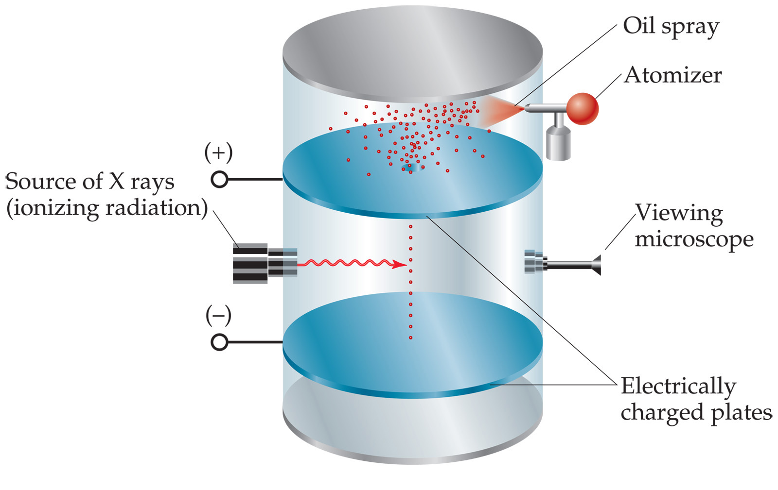
1. Fine oil sprayed into air in top – gravity causes them to fall
John D. Bookstaver
St. Charles Community College
St. Peters, MO
© 2006, Prentice Hall, Inc.

Slide 48
2. A few enter the hole
John D. Bookstaver
St. Charles Community College
St. Peters, MO
© 2006, Prentice Hall, Inc.

Slide 49
Potential difference between plates is applied – exerts a force
on the charged drops
John D. Bookstaver
St. Charles Community College
St. Peters, MO
© 2006, Prentice Hall, Inc.

Slide 50
Top plate is positive enough that negative drops will rise
-
John D. Bookstaver
St. Charles Community College
St. Peters, MO
© 2006, Prentice Hall, Inc.

Slide 51
Potential difference adjusted to suspend (float) particle
-
F_{e} = F_{g}
E*q = m*g
John D. Bookstaver
St. Charles Community College
St. Peters, MO
© 2006, Prentice Hall, Inc.

Slide 52
Electric field was determined from potential difference between two plates (E = V/d)
-
John D. Bookstaver
St. Charles Community College
St. Peters, MO
© 2006, Prentice Hall, Inc.

Slide 53
Found velocity of charge when field was turned off. Using velocity, mg was found. Using E & mg, the charge could be calculated.
-
John D. Bookstaver
St. Charles Community College
St. Peters, MO
© 2006, Prentice Hall, Inc.

Slide 54
The drops had a variety of charges. So, he ionized the air, added or removed electrons. The change in charge was always a multiple of -1.6 x 10⁻¹⁹ C. Thus, the charge on one electron.
-
John D. Bookstaver
St. Charles Community College
St. Peters, MO
© 2006, Prentice Hall, Inc.

Slide 55
Showed that charge is quantized – an object can only have charge with a magnitude that is some integral of the charge of an electron.
-
John D. Bookstaver
St. Charles Community College
St. Peters, MO
© 2006, Prentice Hall, Inc.

